Slide 1
HS001(056-11564-15) P2 MSOP
Made by : Mengbing Sun
Check by：Qinqin Li
Made time：2020-11-18
Check time：2020-11-27
Revision : 05

Slide 2
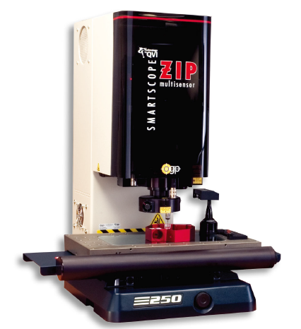
HS001 056-11564-15 MSOP |测量设备-1#
Device name | OMM
Manufacturer | OGP
Device type | ZIP 250
Measuring Range | 250(X)×150(Y)×200(Z) mm
CCD Measuring Accuracy | X,Y: (1.8+6L/1000)μm Z: (2.5+5L/1000)μm (L: measure distance/mm)
Digital counter resolution | 0.001mm
Moving method | Automatic moving

Slide 3
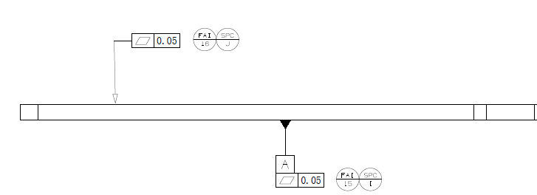
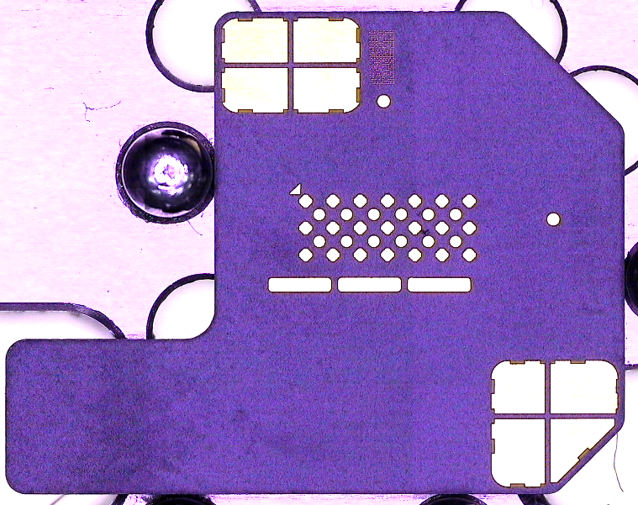
HS001 056-11564-15 | MSOP
FAI/ SPC | -FAI 16 SPC J | Fixture | 量测治具 Measure fixture
Geometric Feature | -Flatness | Measurement Procedure | -Step 1 根据坐标值测量点P1-P22 -Step 2 拟合P1-P22为平面，计算平面度=MAX(P1:P22)+ABS(MIN(P1:P22))为FAI 16 SPC J。 -Step 1 Measure points P1-p22 according to the coordinate values -Step 2 Fit P1-p22 as plane, calculate flatness = MAX (P1: P22) + ABS (min (P1: P22)) as FAI 16 SPC J.
Datums | -Datum1
Measurement Method | -Equipment :OMM -Multiplying power: 208X -Light source: 40%-60%
Profile=FAI 16 SPC J
P1
P2
P3
P4
P5
P6
P7
PL1
P8
P9
P10
P11
 | P1 | P2 | P3 | P4 | P5 | P6 | P7 | P8 | P9 | P10 | P11
X | 12.606 | 8.494 | 4.383 | 12.606 | 8.494 | 4.383 | 1.000 | 12.606 | 8.494 | 4.383 | 1.000
Y | 15.186 | 15.186 | 15.186 | 11.803 | 11.803 | 11.803 | 11.803 | 8.006 | 8.006 | 8.006 | 8.006
 | P12 | P13 | P14 | P15 | P16 | P17 | P18 | P19 | P20 | P21 | P22
X | 19.523 | 16.064 | 12.606 | 8.494 | 4.383 | 1.000 | 19.523 | 16.064 | 12.606 | 8.494 | 4.383
Y | 4.209 | 4.209 | 4.209 | 4.209 | 4.209 | 4.209 | 1.000 | 1.000 | 1.000 | 1.000 | 1.000
P12
P13
P14
P15
P16
P17
P18
P19
P20
P21
P22

Slide 4
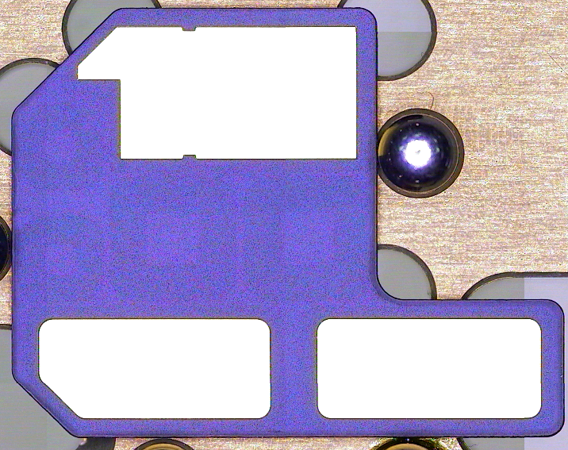
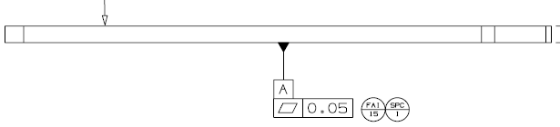
HS001 056-11564-15 | MSOP
FAI/ SPC | -FAI 15 SPC I | Fixture | -量测治具 Measure fixture
Geometric Feature | -Flatness | Measurement Procedure | -Step 1 根据坐标值测量点P1-P22 -Step 2 拟合P1-P22为平面，计算平面度=MAX(P1:P22)+ABS(MIN P1:P22)) 为FAI 15 SPC I。 -Step 1 Measure points P1-p22 according to the coordinate values -Step 2 Fit P1-p22 as plane, calculate flatness = MAX (P1: p22) + ABS (min P1: p22)) Is FAI 15 SPC I.
Datums | -Datum2
Measurement Method | -Equipment :OMM -Multiplying power: 208X -Light source: 40%-60%
P3
P2
P1
PL1 flatness =FAI 15 SPC I
P7
P6
P5
P4
PL1
P11
P10
P9
P8
P17
P16
P15
P14
P13
P12
 | P1 | P2 | P3 | P4 | P5 | P6 | P7 | P8
X | 12.556 | 8.444 | 4.333 | 12.556 | 8.444 | 4.333 | 0.95 | 12.556
Y | 15.186 | 15.186 | 15.186 | 11.803 | 11.803 | 11.803 | 11.803 | 8.006
 | P9 | P10 | P11 | P12 | P13 | P14 | P15 | P16
X | 8.444 | 4.333 | 0.95 | 19.473 | 16.014 | 12.556 | 8.444 | 4.333
Y | 8.006 | 8.006 | 8.006 | 4.209 | 4.209 | 4.209 | 4.209 | 4.209
 | P17 | P18 | P19 | P20 | P21 | P22
X | 0.95 | 19.473 | 16.014 | 12.556 | 8.444 | 4.333
Y | 4.209 | 1.000 | 1.000 | 1.000 | 1.000 | 1.000
P22
P21
P20
P19
P18

